Slide 1
Linear models in R
With continuous explanatory variables

Slide 2
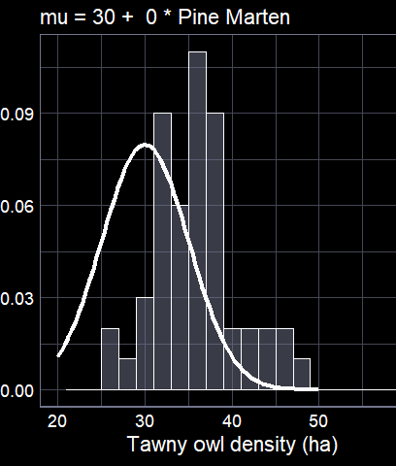
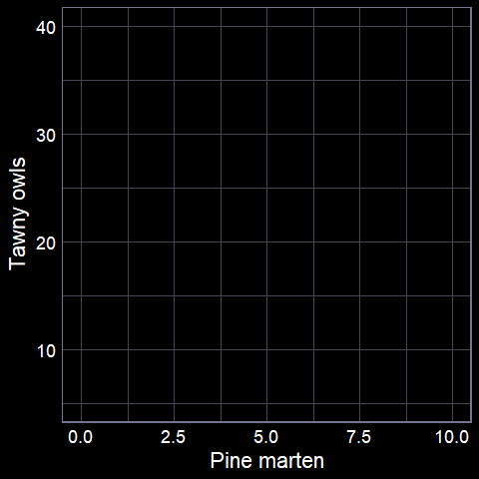

From theory to implementation

Slide 3
The core function
The entire previous lecture is summarised into a single
function in R
lm()
We need to give the function specific information
  The dataset
  The model formula

Slide 4
Step 1: The data

Slide 5
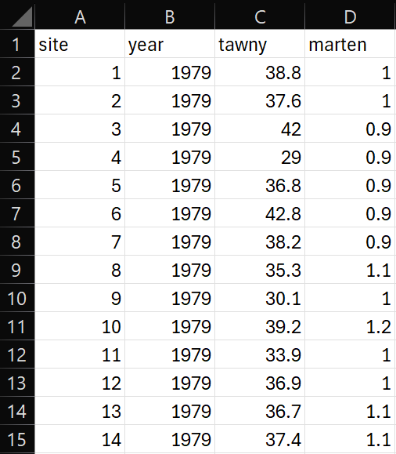
Make sure your data is ready
We want the data in “tabular” form
Where:
  each row is an observation
  each column is a variable
Easiest when data is entered this way from the start
  Otherwise you need to do lots of data processing (with potential mistakes)

Slide 6
Step 2: The formula

Slide 7
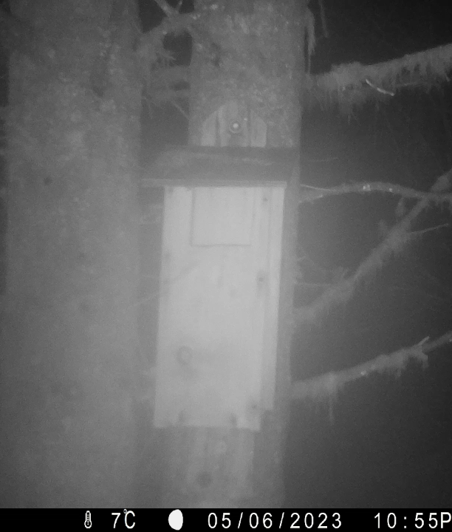
Model formula
We want to understand how owl density changes with pine marten density
  Response variable = owl density
  Explanatory variable = marten density
To convey this to lm():
  owl ~ marten
  In English: “owl as a function of marten”
  In actual English: “Owl density changes with marten density”

Slide 8
Store your model
You can run the model each time you want to do something with it
  E.g. remind yourself what the parameter estimates were
But tedious and annoying
Easiest if you save your model output as an object
  Remember that “<-” stores (or “assigns”) output

Slide 9
Running the model
We ask the model to see if
there is any linear relationship
between tawny owl density and
pine marten density
Run a linear model
Call the stored
output “owl_model”
There is more
information
owl_model <- lm(tawny ~ marten,
data = owl_data)
Store the results
Use the “owl_data” dataset

Slide 10
Step 3: Interpret results

Slide 11

Now what?
Keep in mind, we’re not doing stats for the sake of it
We’re doing it to learn something about the world
Our current model has two parameters we want to learn
  Intercept ($β_{0}$)
  Slope ($β_{1}$)
How do we get that information?

Slide 12
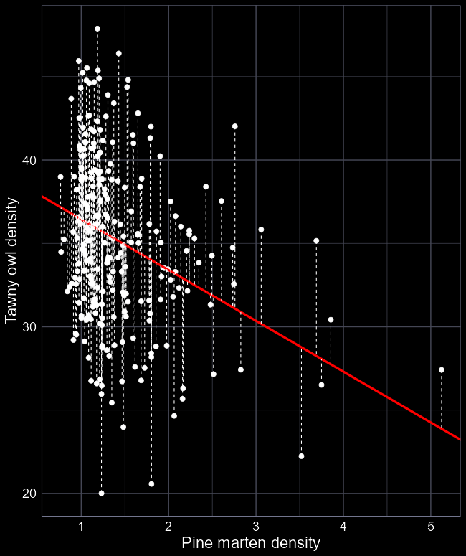
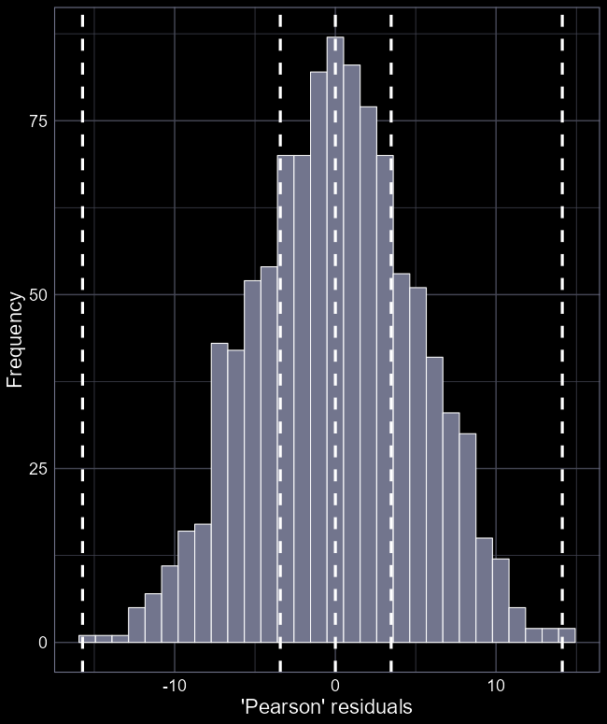
summary(owl_model)
Call:
lm(formula = tawny ~ marten, data = owl_data)
Residuals:
Min 1Q Median 3Q Max
-15.7312 -3.4267 0.0008 3.4721 14.1214
Coefficients:
Estimate Std. Error t value Pr(>|t|)
(Intercept) 39.4934 0.4239 93.16 <2e-16 ***
marten -3.0465 0.2780 -10.96 <2e-16 ***
---
Signif. codes: 0 ‘***’ 0.001 ‘**’ 0.01 ‘*’ 0.05 ‘.’ 0.1 ‘ ’ 1
Residual standard error: 5.015 on 1033 degrees of freedom
Multiple R-squared: 0.1042, Adjusted R-squared: 0.1033
F-statistic: 120.1 on 1 and 1033 DF, p-value: < 2.2e-16
Which model this is
Simple description of residuals
The biologically important parameter estimates

Slide 13
Done?
Estimate
(Intercept) 39.4934
marten -3.0465

Slide 14
Step 4: Plot results

Slide 15
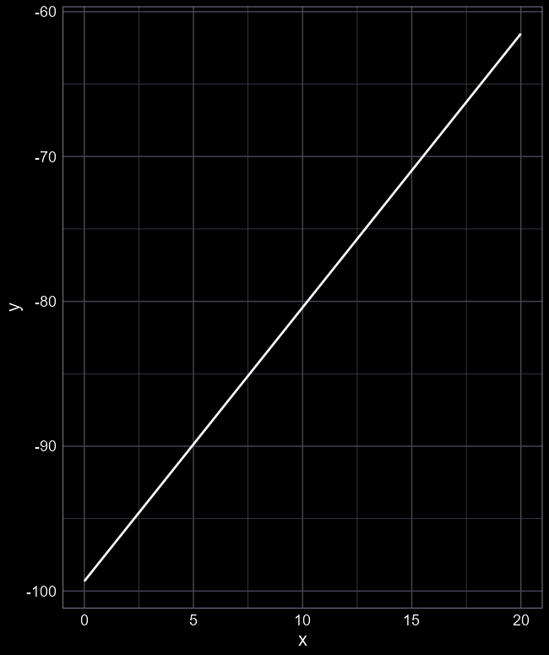

Make life easy for your audience
Reporting the actual parameter estimates is important
  Transparency and precision
But visualising the results is much more intuitive and helps non-technical readers to grasp the meaning
For example, which is easier:
  “$β_{0}$ was estimated at -99.32 and $β_{1}$ was estimated at 1.89”
  Or a figure?

Slide 16

Drawing a line
To draw a line, we need a straight line equation
$$μ=β_{0}+β_{1}×Marten$$
Now that we’ve fit the model, we know what $β_{0}$ and $β_{1}$ are
We just need values for $Martin$
We could just use the actual values from our dataset
  But this can cause difficulties later on
Or we can just make up values

Slide 17
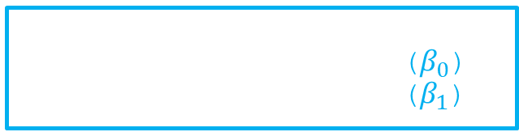

Our objective to make the figure
$$μ=β_{0}+β_{1}×Marten$$
We can get these by doing:
summary(owl_model)
Estimate
(Intercept) 39.4934 ($β_{0}$)
marten -3.0465 ($β_{1}$)

Slide 18

Our objective to make the figure
We just need values
to plug in here
$$μ=39.5−3.1×Marten$$

Slide 19
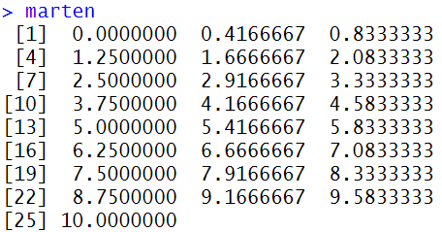

Making up numbers
We want a simple list of sequential values of $Marten$
R is excellent at doing this
We can use the seq() function
  seq() for “sequence”
marten <- seq(from = 0,
to = 10,
length.out = 25)
Creates a sequence of 25 numbers from 0 marten to 10 marten, and stores it as “marten”.

Slide 20

Our objective to make the figure
$$μ=39.5−3.1×Marten$$

Slide 21
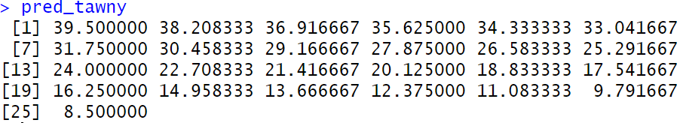

Our objective to make the figure
$$μ=39.5−3.1×Marten$$
pred_tawny <- 39.5 – 3.1 * marten

Slide 22
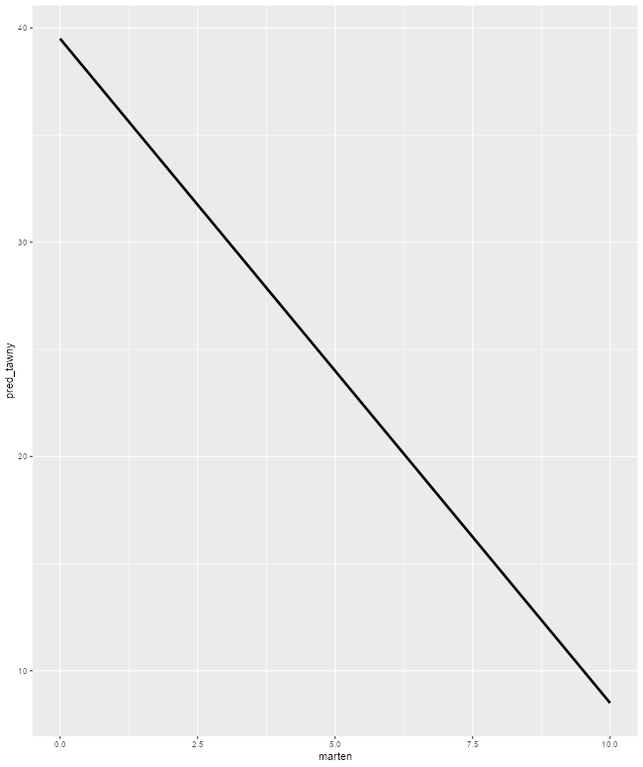
ggplot
We learned how to plot data using ggplot in the first week
We’ll use those skills again here
Specifically, we want to use the geom_line geometry to plot a line
ggplot() +
geom_line(aes(x = marten,
y = pred_tawny))

Slide 23
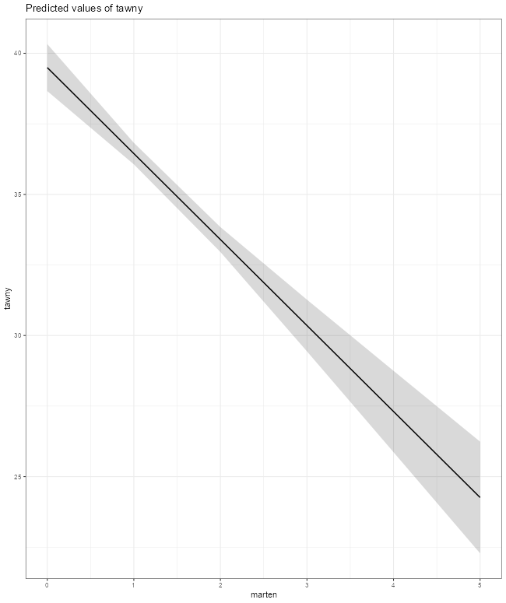
An easier alternative
There are various R packages that make plotting model fits easy
But they do come with the cost of limiting your choices
  Useful when learning
  But annoying when you want to make those choices
ggeffects() package is a nice option
  But not the only one
library(ggeffects)
plot(ggpredict(owl_model))

Slide 24
tl;dr
Actually fitting models in R is easy
  Ensure data is in tabular form
  Get the formula that captures your question
lm() handles all of the theory
Use summary() to extract the parameter estimates
Report the estimates!
Create a simple version of your explanatory variable
  Use your equation to generate fitted values
  Plot them using your software of preference

